Slide 1
Automation Release Emails with Logic App
Snehal Patel
Oday Alfarttosi

Slide 2
AGENDA
Overview
Pre-requisites Steps
Steps for Logic App
Summary

Slide 3
Overview
The purpose of this task is to automate the process of sending release emails using Logic Apps. The release emails will notify recipients about upcoming releases and provide information about the changes to be deployed. The Logic App will be scheduled to run every day at 9pm to ensure timely delivery of the release notifications

Slide 4
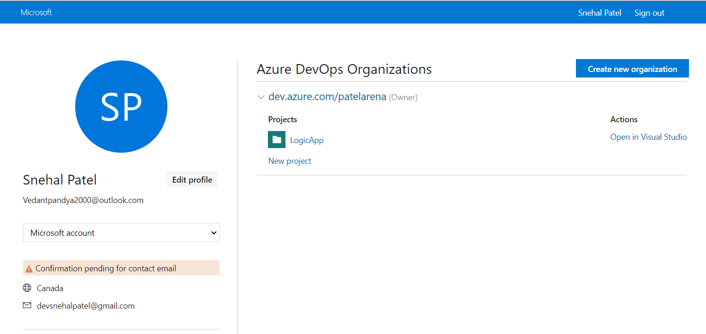
Pre-requisite Steps azure Devops Organization setup
Create an Azure DevOps Organization to store work items and queries

Slide 5
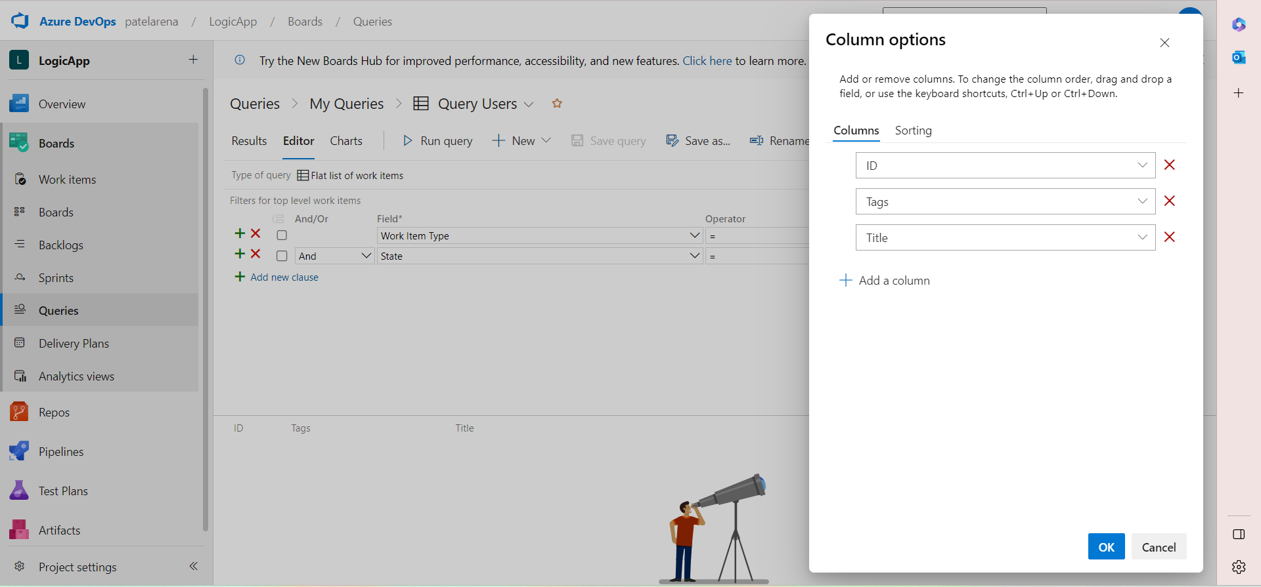
Pre-requisite Steps Queries setup
Create a query in Azure DevOps that retrieves the relevant user stories for the release. The query should include the following fields: System.Tags, System.Id, and System.Title. Note the query ID for later use.

Slide 6
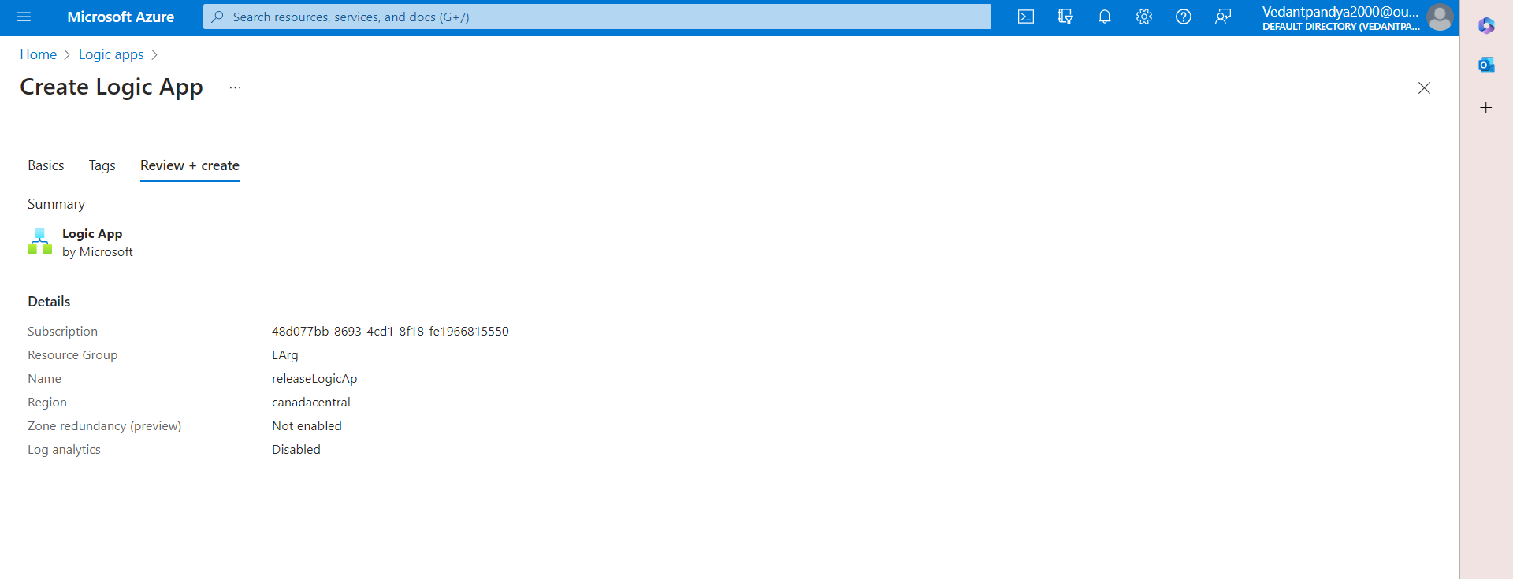
Logic App Configuration
Create a new Logic App in your Azure environment. Choose the desired trigger for the Logic App, such as a manual trigger or a recurring schedule

Slide 7
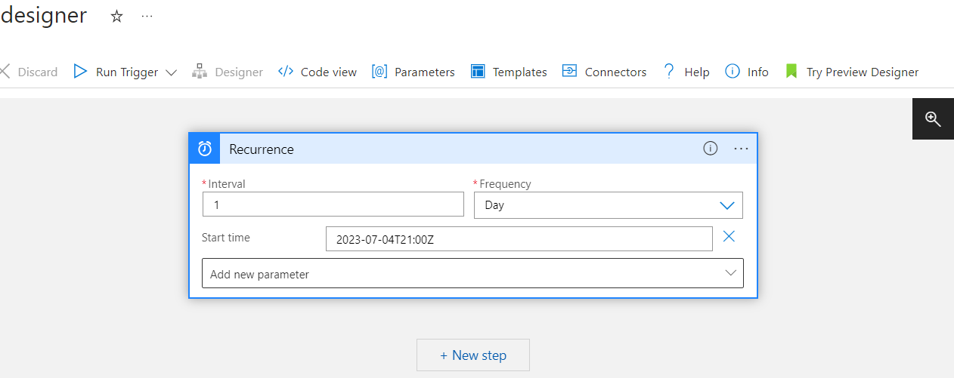
Logic App Configuration
2. Configure the trigger to have a recurrence pattern for executing the Logic App every day at 9pm. This ensures that the release emails are sent at the specified time and recipients receive timely notifications.

Slide 8
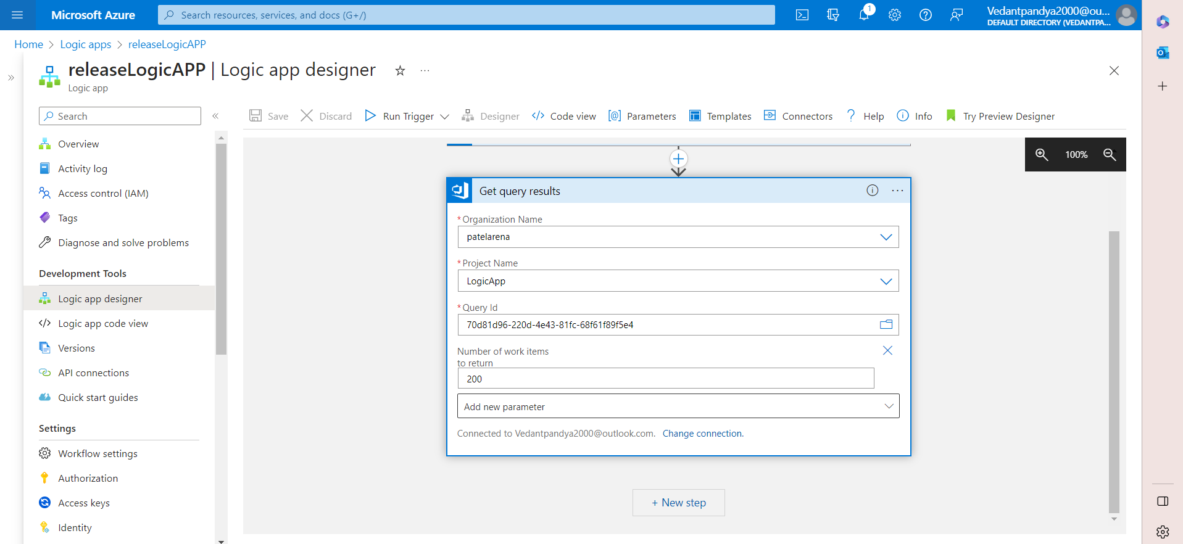
Logic App Configuration
3. Add the action Get_query_results to the Logic App workflow. Configure the connection to Azure DevOps by providing the necessary credentials. Specify the query ID obtained in the prerequisites to retrieve the query results containing the user stories for the release.

Slide 9
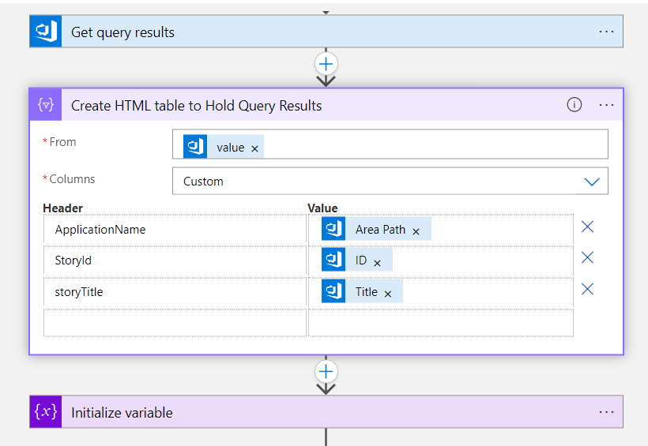
Logic App Configuration
4. Add the action Create_HTML_table_to_Hold_Query_Results to the Logic App workflow. This action creates an HTML table to hold the query results. Customize the columns section of the action to include the necessary tags for extracting the values of the application name, story ID, and story title.

Slide 10
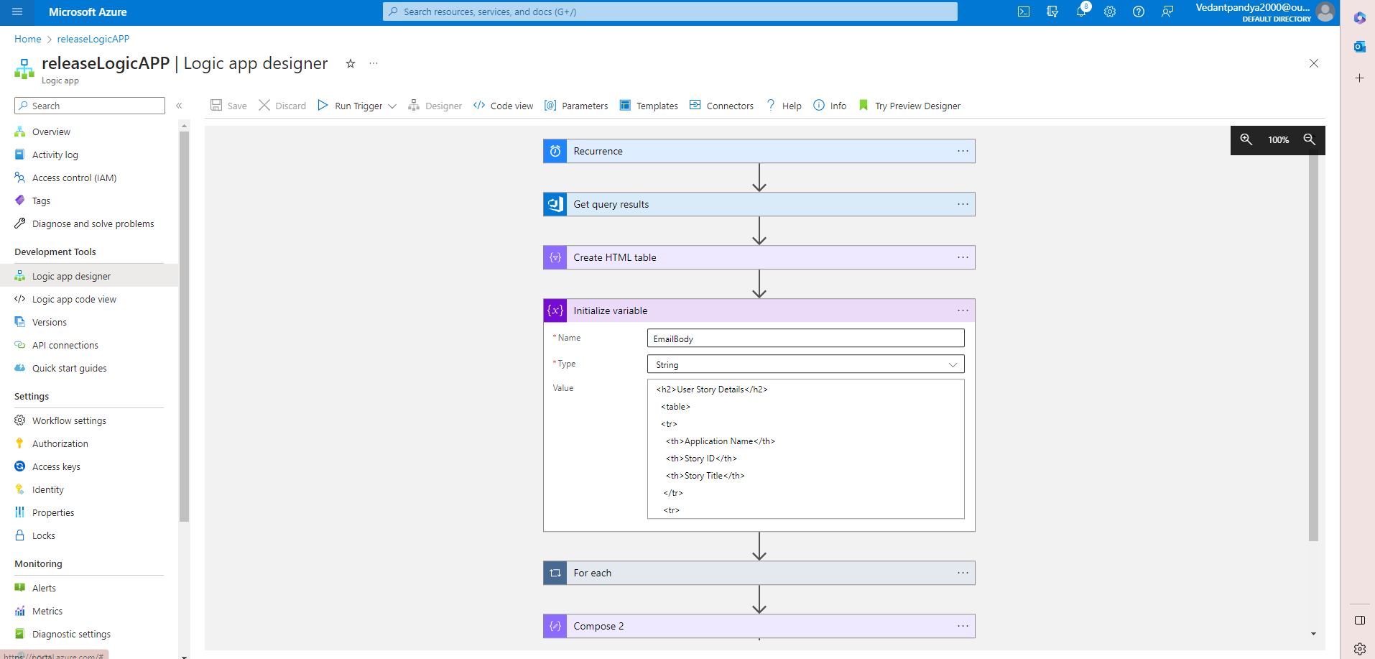
Logic App Configuration
5. Add the action Initialize_variable to the Logic App workflow. Set the variable type as a string and name it "EmailBody". This variable will store the HTML content of the email body.

Slide 11
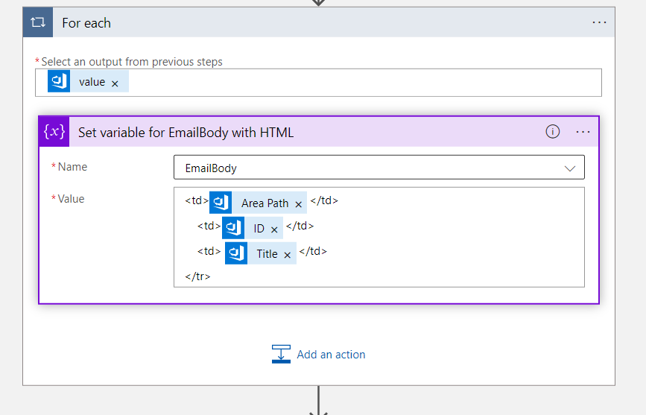
Logic App Configuration
6. Add the action For_each to the Logic App workflow. Configure it to iterate over the query results obtained from the Get_query_results action. This loop allows you to dynamically retrieve information from each user story and include it in the email body.
7. Within the For_each loop, add the action Set_variable_for_EmailBody_with_HTML. In this action, write the HTML code for the email body, including placeholders for the application name, story ID, and story title. Use expressions and dynamic content to populate the placeholders with the actual values from each user story.

Slide 12
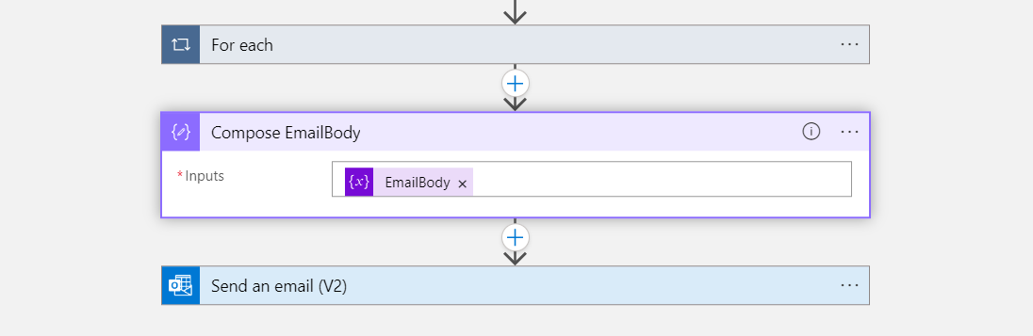
Logic App Configuration
8. Add the action Compose_EmailBody after the For_each loop. Configure the input of this action to retrieve the value of the "EmailBody" variable. This action allows you to generate the final HTML content of the email body

Slide 13
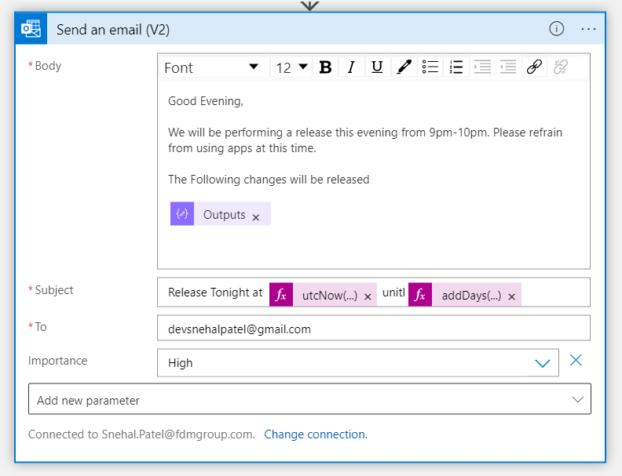
Logic App Configuration
9. Add the action Send_an_email_(V2) to the Logic App workflow. Configure the connection to Office 365 and specify the email recipients, subject, and body. In the body section, include the output from the Compose_EmailBody action. This ensures that the content of the email is populated with the HTML content generated by the Logic App.
Configure the "To" field with your email.
Set the "Subject" field to a relevant subject line. It will be “Release Tonight at @startDate until @nextDate’’.

Slide 14
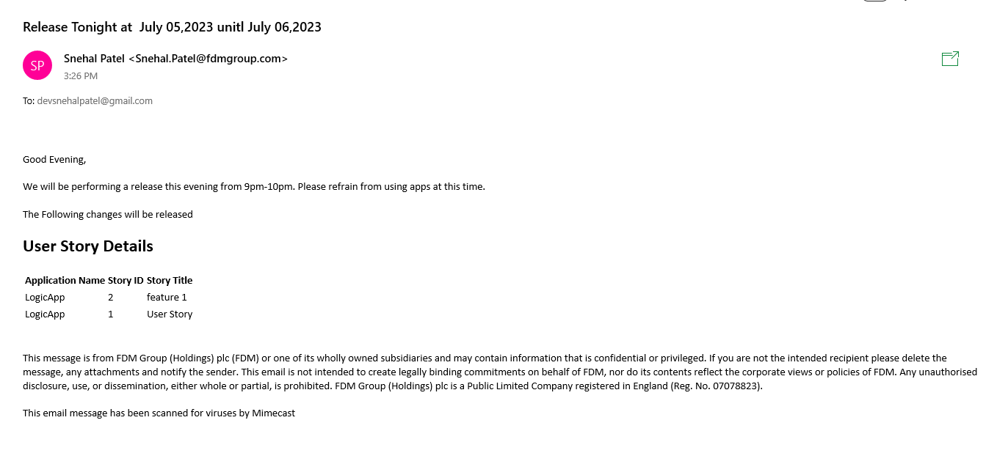
Email Received output

Slide 15
SUMMARY
Logic Apps are very simpler and faster way to communicate automated email regarding any release, warning, doing a repetitive task and much more which helps to reduce manual work that took a lot of time. We can integrate logic app to deploy resource, to delete any resource, to send alert emails, to send SMS, and much more.
This project helped us understand how we can integrate an DevOps Organization with Logic app and send automated email regarding any release. We integrated Work Items using queries from where the information regarding release feature is returned and an email is created using Logic app and send to the recipients.

Slide 16

THANK YOU

